Slide 1
Detecting Phishing Websites Using Hybrid Model
Group 28
Hyder Reza Telegraphy (A20527634)
Juveriya Fatima (A20528182)
Shadaan Arzeen (A20528043)

Slide 2
Motivation
The motivation for this project is the growing prevalence of phishing attacks in recent years, which poses a significant threat to users' personal and sensitive information.
Phishing attacks use social engineering methods to trick unsuspecting users into entering their personal information on fake websites that appear to be authentic.
Despite constant efforts to educate users on how to identify these fake websites, many users are still vulnerable to these attacks, which highlights the need for effective methods to identify and prevent such attacks.

Slide 3
Problem Description
The problem description revolves around the need for a constructive technique to detect and prevent phishing attacks.
This project aims to address this problem by proposing a hybrid model approach in machine learning that combines multiple algorithms to achieve high accuracy in identifying and preventing phishing attacks.
The proposed solution aims to provide users with a reliable and effective method for detecting and avoiding phishing websites, ultimately enhancing cyber-security and protecting user data.

Slide 4
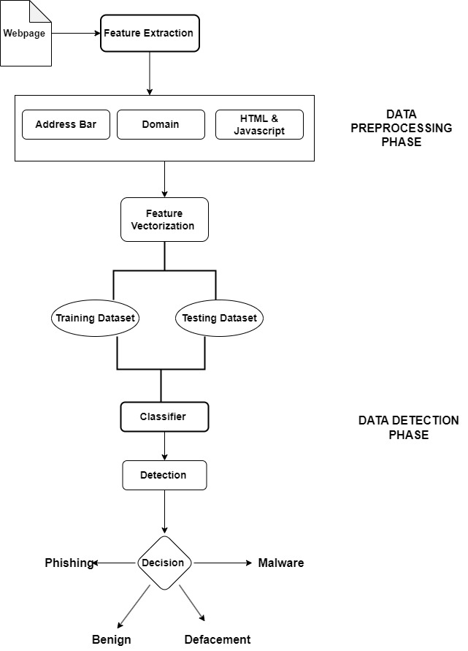
Methodology
Loading dataset
Exploratory Data Analysis (EDA)
Feature engineering
Label Encoding
Training & Test Split
Model Training
Model evaluation & comparison
Model prediction

Slide 5
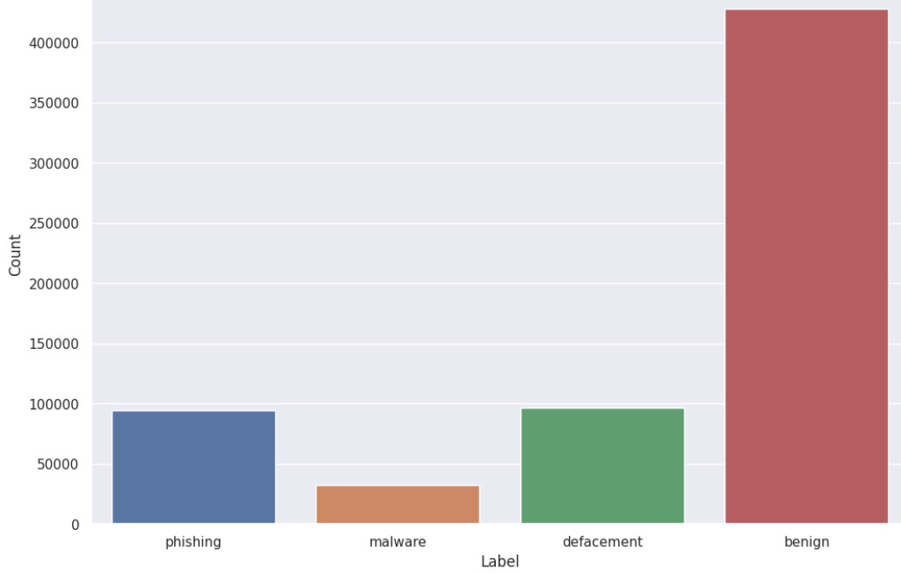
Dataset
Malicious URLs dataset of 6,51,191 URLs is used.
4,28,103 are benign or safe 96,457 are defacement,
94,111 are phishing, and 32,520 are malware.
The ISCX-URL-2016 dataset is used to collect URLs classified as benign, phishing, malware, and defacement.
Notes:
The dataset that we decided to use for the project is derived from University of New Brunswick.
It consists of over 651,191 samples with it’s corresponding target labels which are classified as benign, malicious, defacement and phishing.
Here you can see the distribution of the target variables in the dataset.
Let me define the target labels clearly to you all so that you can have a better understanding of its nature.
Benign basically are URLS which are safe to browse.
Malicious are URLs which inject malware into the victim’s system once they visit such URLs.
Defacement are URLs in which the perpetrator uses methods like code injection, cross-site scripting, etc. with the goal of infiltrating a web server and replacing the hosted website with one of their own.
Lastly, Phishing are those URLs that attempt to steal sensitive confidential information from those users that visit them.

Slide 6
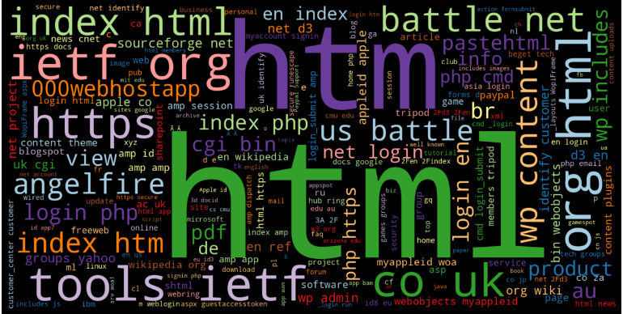
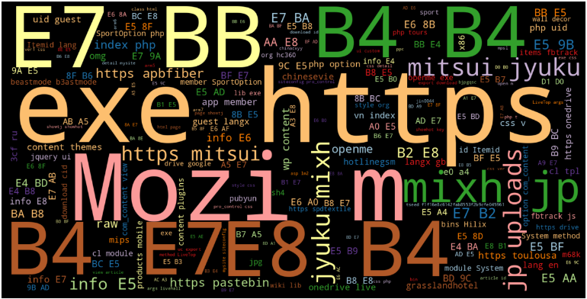
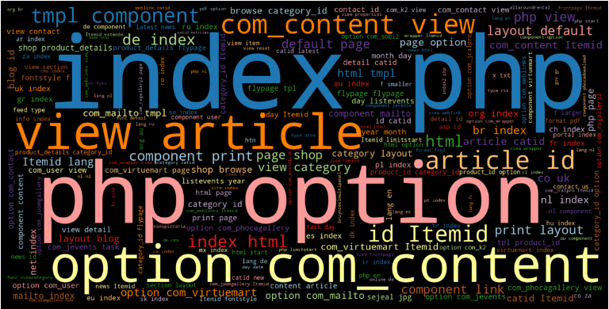
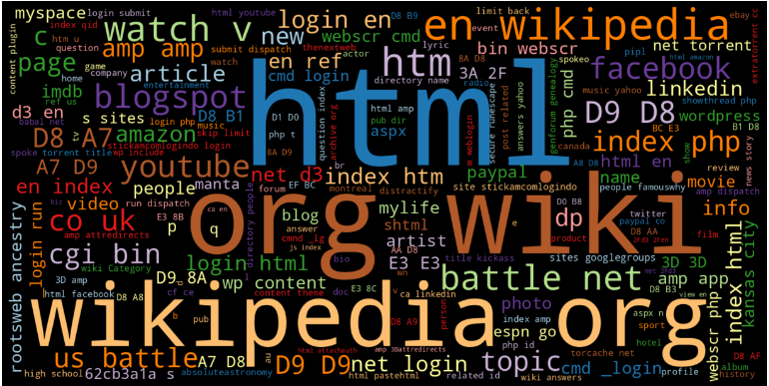
URL Wordmap
Phishing | Malware
Defacement | Benign
Notes:
After performing an exploratory data analysis, we present you with a word map of the terms that were most commonly found in URLs of each of the target labels.
In phishing, as I’ve defined in the previous slide, the perpetrators often manipulate HTML elements of the website to trick the victim into entering their confidential information.
Over at Malicious, the perpetrator tries to use various scripts which gets executed if a victim accidentally visit such websites.
Moving over to Defacement, the most common tactic found to trick victims is to embed another domain by manipulating PHP scripts.
Benign as it speaks for itself are safe websites such as Wikipedia or trusted organizations.

Slide 7
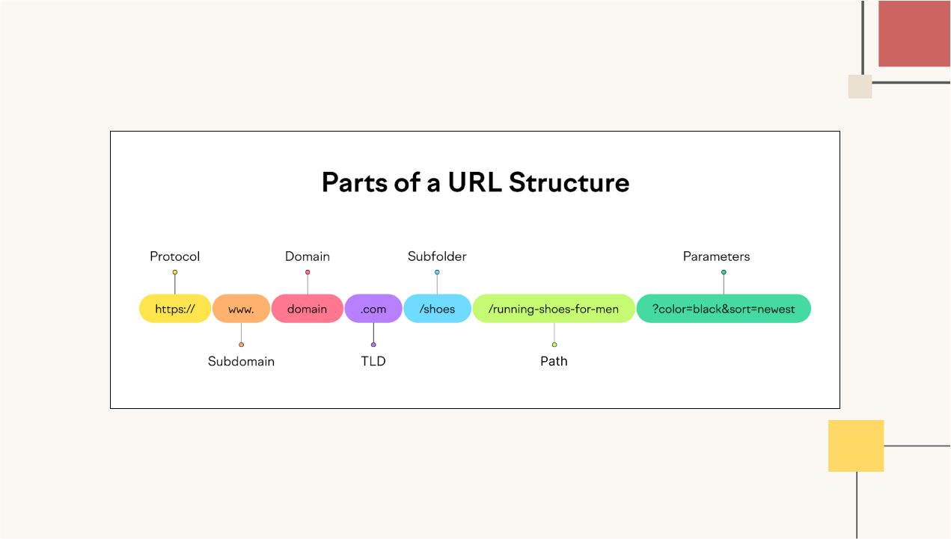
Feature Selection
Feature Selection
Notes:
I’m sure you are aware of the URL structure consisting of the following segments: protocols, subdomain, domain, etc.
A little insight into this will help you understand the following slides that I shall be briefing you on now.

Slide 8
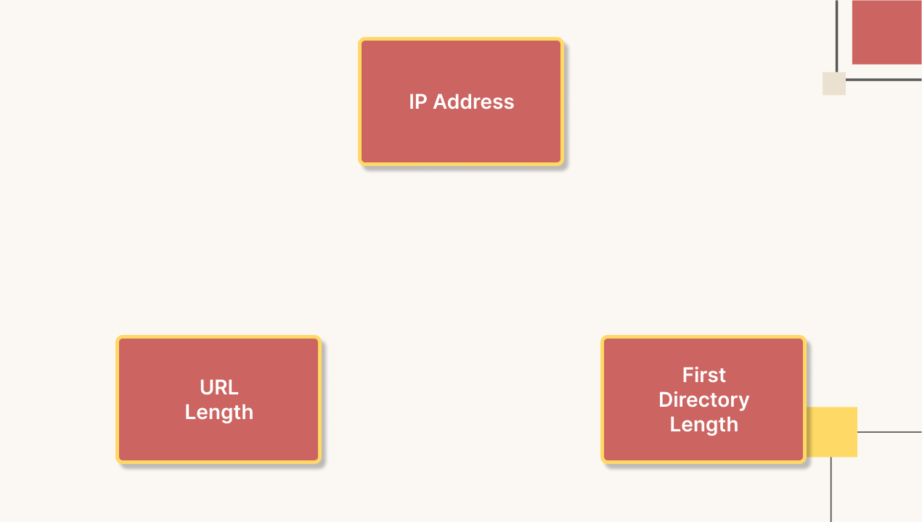
Address Based Features
Notes:
These are features based on the Address of the URL.
Generally cyber attackers use an IP address in place of the domain name to hide the identity of the website. So we investigate whether a URL consists of a domain name or an IP address as one of the feature.
Attackers generally use long URLs to hide the domain name. We found the average length of a safe URL to be 74.
First Directory Length is basically the length of the first path. If the First Directory Length of a website's URL is different from the expected length of the legitimate website's URL, it can be a sign of a phishing attempt.

Slide 9
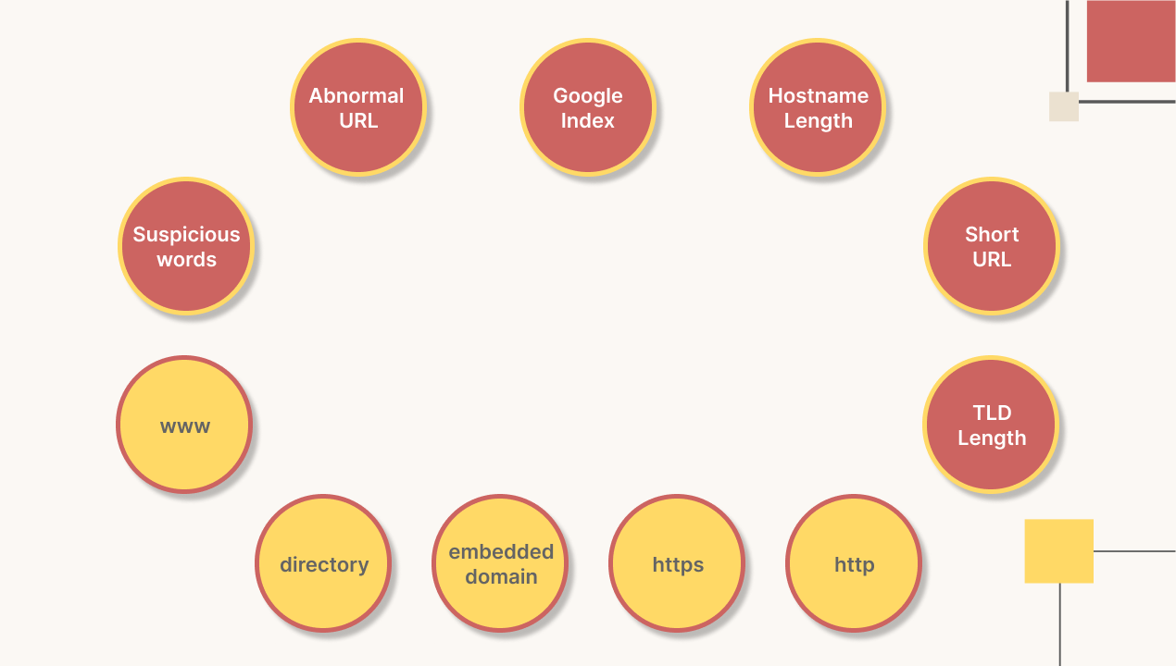
Domain Based Features
Notes:
Other attributes to consider are:
Abnormal URL indicates whether the url being investigated has a standard pattern of a valid URL.
Most harmful websites don’t tend to be ranked on the google index. So, a website without one indicates a possibility that it is a trap. And one with a g-index indicates that the website is known to be safe and accessed by a lot of users.
Compare length of the hostname with that of any legitimate website.
Short URLs tend to conceal the absolute length of the URL. So, this is another aspect that we have to lookout for.
TLD are top-level domain length. The .com and .in at the end of the URL are typically of length 2 and 3 and anything besides that tend to be suspicious.
The rest of the spheres in yellow basically checks the count of the terms in URL and whether they contain any embedded domain or not.

Slide 10
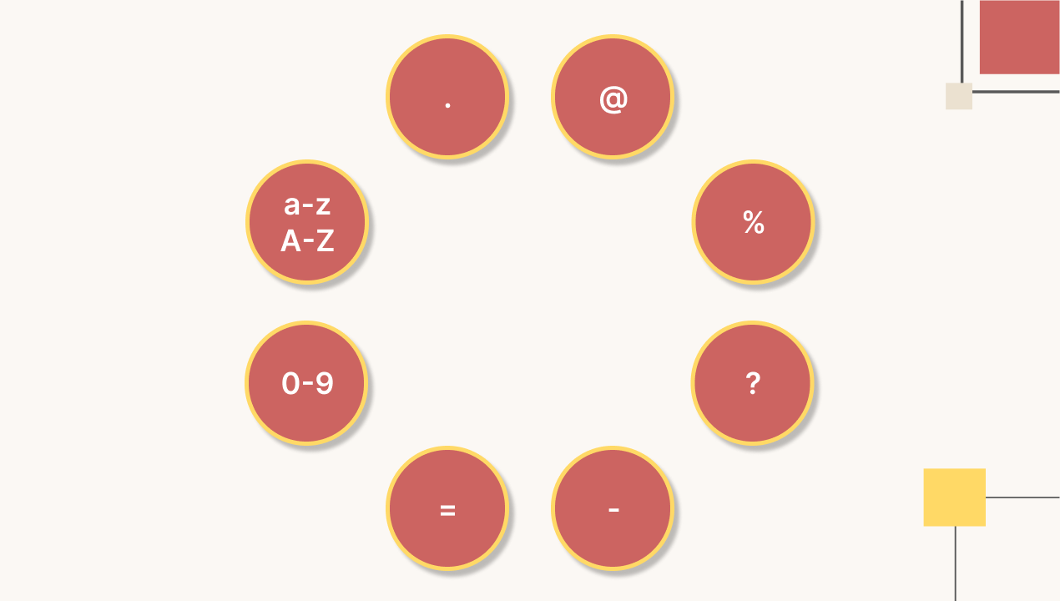
Character Count
Notes:
Finally, we also lookout for suspicious characters in URLs such as their count or length and their position in the URL.

Slide 11
Model Selection
Logistic Regression
Naive Bayes
Random Forest
Decision Trees
Light GBM
XGBoost
Autoencoder Neural Network
Multilayer Perceptron

Slide 12
ML Model Performance on Existing Dataset
Model | Class | Precision | Recall | F1 Score
Logistic Regression | Benign | 0.89 | 0.97 | 0.93
 | Defacement | 0.84 | 0.93 | 0.89
 | Phishing | 0.81 | 0.72 | 0.76
 | Malware | 0.76 | 0.40 | 0.52
Naïve Bayes | Benign | 0.91 | 0.89 | 0.90
 | Defacement | 0.64 | 1.00 | 0.78
 | Phishing | 0.59 | 0.55 | 0.57
 | Malware | 0.71 | 0.38 | 0.50

Slide 13
ML Model Performance on Existing Dataset
Model | Class | Precision | Recall | F1 Score
Random Forest | Benign | 0.97 | 0.98 | 0.98
 | Defacement | 0.98 | 0.99 | 0.99
 | Phishing | 0.99 | 0.94 | 0.96
 | Malware | 0.91 | 0.86 | 0.88
Decision Tree | Benign | 0.97 | 0.98 | 0.97
 | Defacement | 0.98 | 0.99 | 0.98
 | Phishing | 0.95 | 0.94 | 0.95
 | Malware | 0.87 | 0.84 | 0.86

Slide 14
ML Model Performance on Existing Dataset
Model | Class | Precision | Recall | F1 Score
XGBoost Classifier | Benign | 0.97 | 0.99 | 0.98
 | Defacement | 0.97 | 0.99 | 0.98
 | Phishing | 0.97 | 0.92 | 0.94
 | Malware | 0.91 | 0.83 | 0.87
Light GBM Classifier | Benign | 0.97 | 0.99 | 0398
 | Defacement | 0.96 | 0.99 | 0.98
 | Phishing | 0.97 | 0.90 | 0.93
 | Malware | 0.90 | 0.83 | 0.86

Slide 15
ML Model Performance on Existing Dataset
Model | Class | Precision | Recall | F1 Score
Multilayer Perceptrons | Benign | 0.97 | 0.98 | 0.97
 | Defacement | 0.95 | 0.97 | 0.96
 | Phishing | 0.94 | 0.87 | 0.90
 | Malware | 0.87 | 0.82 | 0.85

Slide 16
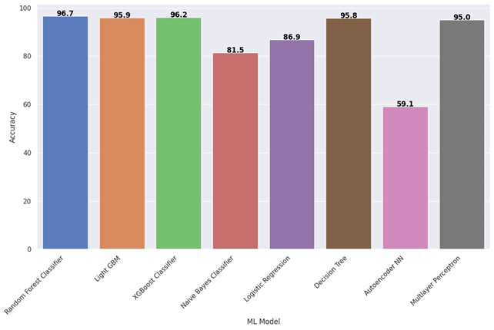
Model Comparison

Slide 17
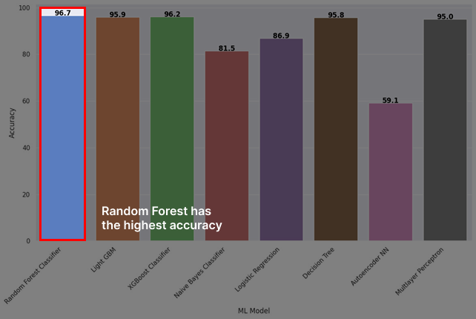
Model Comparison

Slide 18
Future Work
The model can be deployed and used in the real world. A system that can detect phishing websites in real-time can be built.
The model can be integrated with other security tools and services.

Slide 19
Thank you

